Slide 1
Risk
A project risk is an uncertain event or condition that, if it occurs, has a positive or negative effect on one or more project objectives such as:
Scope
Schedule
Cost
Quality
📌 Risk ≠ Problem
Risk: May happen
Issue/Problem: Has already happened

Slide 2
Risk Management
Risk is an uncertain event or condition that, if it occurs, has a positive or negative effect on one or more project objectives such as scope, schedule, cost, quality, or performance.
Key points:
Risk is about uncertainty
It may have negative effects (threats) or positive effects (opportunities)
Risks exist in all projects, especially IT projects
Characteristics of Risk
Future-oriented
Uncertain in nature
Has a cause and an effect
Can impact cost, time, quality, scope, or reputation
Can be managed but not completely eliminated

Slide 3
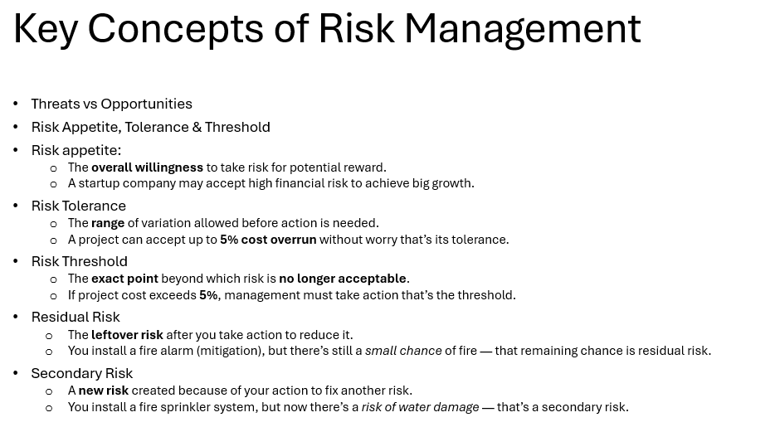

Slide 4
Risk Managment
Types of Risk
Based on Impact
Negative Risk (Threat)
Events that can harm the project.
Example (IT Company):
Cybersecurity breach delaying software release
Key developer resigns during critical phase
Positive Risk (Opportunity)
Events that can benefit the project.
Example:
Use of a new automation tool reduces development time
Client requests additional features with extra payment

Slide 5
Types of Risk in IT Projects
Technical Risk
Risks related to technology, tools, or systems.
Examples:
New programming framework is unstable
Integration failure between legacy system and new software
Project Management Risk
Risks related to planning, scheduling, and control.
Examples:
Poor effort estimation
Inadequate communication among teams
Unrealistic deadlines

Slide 6
Types of Risks in IT Projects
Business / Organizational Risk
Risks related to organizational environment.
Examples:
Change in company strategy
Budget cuts from management
Client organization restructuring
External Risk
Risks outside the organization’s control.
Examples:
Changes in government IT regulations
New data privacy laws (GDPR)
Vendor failure

Slide 7
Types of Risks in IT Projects
Resource Risk
Risks related to human or material resources.
Examples:
Skilled developers not available
High employee attrition rate
Dependency on a single expert
Security Risk
Very critical in IT projects.
Examples:
Data theft
Malware attacks
Unauthorized access

Slide 8
Why Risk Needs to Be Managed
Risk management is essential because:
Prevents project failure
Reduces cost overruns
Avoids schedule delays
Improves decision-making
Increases chances of project success
Improves stakeholder confidence
Helps identify opportunities
Example: Early identification of performance risk in a cloud application helps allocate better infrastructure, avoiding customer complaints later.

Slide 9
Importance of Risk Management
Risk Management helps to:
Reduce project failures
Improve decision-making
Increase probability of project success
Protect project objectives
Identify opportunities (positive risks)
Example
If a software project ignores the risk of changing requirements, it may lead to:
Cost overrun
Schedule delay
Poor quality

Slide 10
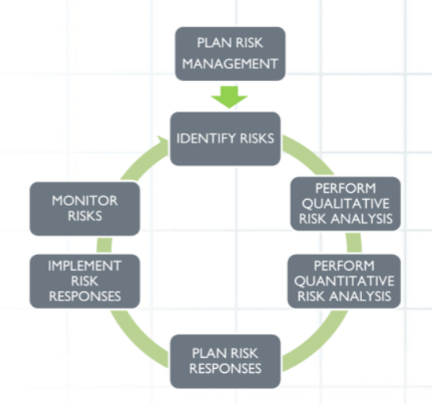
PMBOK Risk Management Processes
According to PMBOK, Project Risk Management consists of 7 processes:
Plan Risk Management
Identify Risks
Perform Qualitative Risk Analysis
Perform Quantitative Risk Analysis
Plan Risk Responses
Implement Risk Responses
Monitor Risks

Slide 11
Plan Risk Management
The process of defining how to conduct risk management activities for the project.
Outputs
Risk Management Plan
Contents of Risk Management Plan
Risk methodology
Roles and responsibilities
Risk categories
Probability and impact definitions
Risk thresholds
Reporting formats
Example
A construction project decides:
High risk = delay > 30 days
Risk review every 2 weeks

Slide 12
Identify Risks
The process of identifying individual project risks and documenting their characteristics.
Techniques
Brainstorming
Expert judgment
Checklists
SWOT analysis
Document review
Interviews
Output
Risk Register
Risk Register Contains
Risk description
Risk cause
Risk impact
Risk owner
Example
Risk:
“Key developer may leave the project.”
Cause: Better job offer Impact: Schedule delay

Slide 13
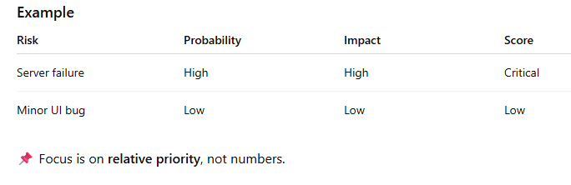
Perform Qualitative Risk Analysis
The process of prioritizing risks based on:
Probability of occurrence
Impact on project objectives
Tools
Probability–Impact Matrix
Risk categorization
Expert judgment
Risk Rating Formula
Risk Score = Probability × Impact

Slide 14
Objectives of Qualitative Risk Analysis
Rank risks based on importance
Identify critical risks requiring immediate response
Reduce the number of risks for quantitative analysis
Support better decision-making
Optimize use of time and resources

Slide 15
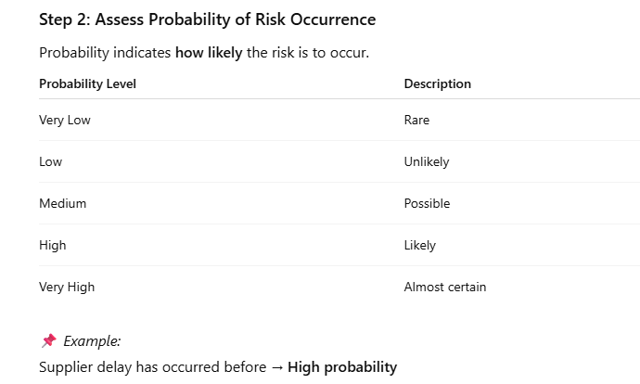
Steps to perform qualitative risk analysis
Step 1: Review Identified Risks
Use the Risk Register
Ensure risk statements are clear and complete
📌 Example: Risk: “Delay in delivery of hardware due to supplier issues.”

Slide 16
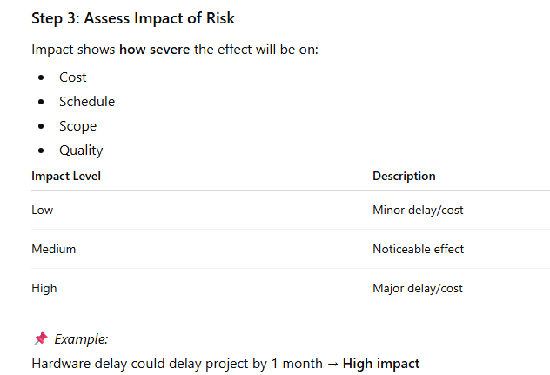
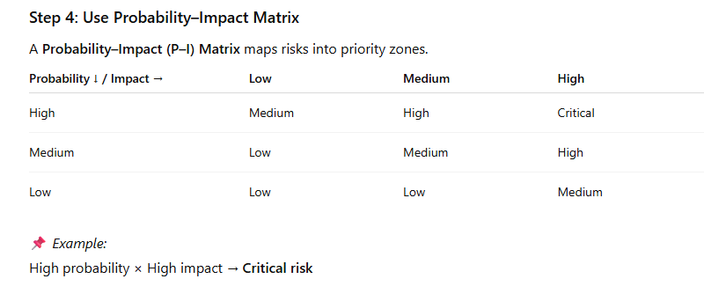
Steps to perform qualitative risk analysis

Slide 17
Steps to perform qualitative risk analysis
Step 5: Risk Prioritization
Assign risk ratings (High / Medium / Low)
Sort risks based on priority
Focus on top-ranked risks
📌 Example: Critical risks → Immediate response Low risks → Watch list
Step 6: Assign Risk Owners
Each risk is assigned to a responsible person
Ensures accountability
📌 Example: Vendor delay risk → Procurement Manager

Slide 18
Steps to perform qualitative risk analysis
Step 7: Update Risk Register
The risk register is updated with:
Probability
Impact
Risk rating
Risk owner
Response strategy (optional)

Slide 19
Types of Qualitative Risk Analysis
1. Probability-Based Analysis
Focuses only on likelihood
Used in early project stages
📌 Example: Risk of requirement change is high
2. Impact-Based Analysis
Focuses on severity of consequences
📌 Example: Data loss has very high impact
3. Probability–Impact Analysis
Most common method
Combines probability and impact
📌 Example: High probability + Medium impact = High risk

Slide 20
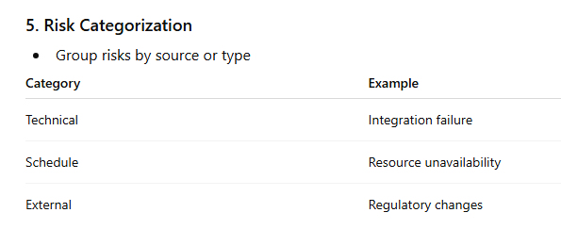
Types of Qualitative Risk Analysis
4. Risk Urgency Assessment
Evaluates how soon the risk may occur
📌 Example: Risk happening next week → High urgency

Slide 21
Tools used
Expert judgment
Brainstorming
Probability–Impact Matrix
Risk categorization
SWOT analysis
Risk data quality assessment

Slide 22
Expert Judgment
Expert judgment involves using the knowledge and experience of subject matter experts (SMEs), such as:
Senior project managers
Technical experts
Industry specialists
Consultants
Experts help in:
Identifying risks
Assessing probability and impact
Prioritizing risks
Suggesting response strategies
Example
In a software development project, an experienced architect states:
“Using a new framework has a high risk of integration failure.”
Based on this expert input:
Probability → High
Impact → High
Risk Priority → Critical
📌 Expert judgment is especially useful when historical data is limited.

Slide 23
Brainstorming
Brainstorming is a group creativity technique where project team members and stakeholders:
Freely suggest potential risks
Avoid criticism during idea generation
Aim to identify as many risks as possible
It encourages open discussion and collective thinking.
Example
In a construction project, a brainstorming session identifies risks such as:
Labor strike
Delay in material delivery
Bad weather
Equipment breakdown
These risks are then documented in the risk register.
📌 Brainstorming is commonly used during the risk identification phase, but also supports qualitative analysis.

Slide 24
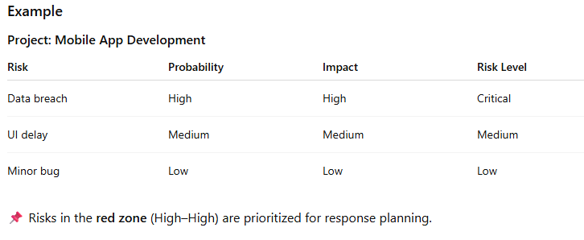
Probability–Impact Matrix
A Probability–Impact (P–I) Matrix is a visual tool used to:
Combine probability and impact
Rank risks as High, Medium, or Low
Identify which risks need immediate action
Risk Score = Probability × Impact

Slide 25
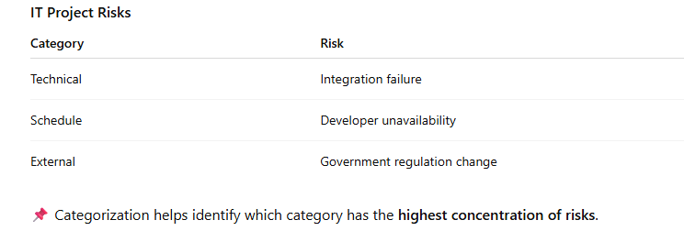
Risk Categorization
Risk categorization involves grouping risks based on their source or nature, making it easier to:
Identify common problem areas
Assign responsibility
Plan category-specific responses
Often organized using a Risk Breakdown Structure (RBS).
Common Risk Categories
Technical
Schedule
Cost
Resource
External
Organizational

Slide 26
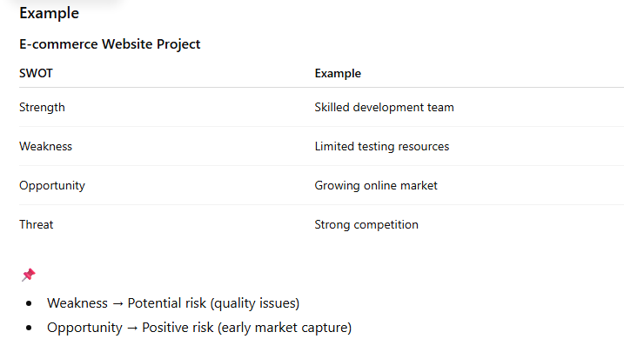
SWOT Analysis
SWOT Analysis evaluates:
Strengths
Weaknesses
Opportunities
Threats
It helps identify both positive and negative risks.

Slide 27
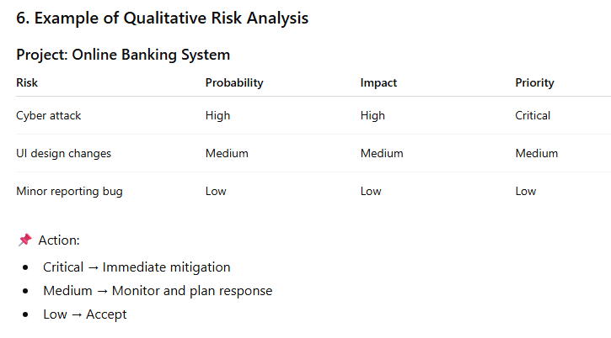
Example

Slide 28
Pros Cons
8. Advantages of Qualitative Risk Analysis
Simple and fast
Easy to understand
Useful when data is limited
Helps focus on major risks
9. Limitations of Qualitative Risk Analysis
Subjective
Depends on expert judgment
Not suitable for cost estimation
Less accurate for complex projects

Slide 29
Perform quantitative Risk Analysis
Quantitative Risk Analysis is the process of numerically analyzing the effect of identified risks on project objectives, such as:
Schedule
Cost
Scope
Quality
Unlike qualitative risk analysis, which focuses on ranking risks as High, Medium, or Low, quantitative analysis uses mathematical models and data to estimate the magnitude and probability of the impact.
The aim is to provide a numeric estimate of the potential impact of risks, helping project managers make informed decisions regarding risk responses.
When to Use QRA?
Large, complex projects
When decision-makers require precise information on risk impact
When accurate cost and schedule predictions are crucial

Slide 30
Steps in Quantitative Risk Analysis
Step 1: Define the Risk Parameters
Before any quantitative analysis can begin, the following must be clearly defined:
Risk events
Impacts
Risk responses
Example
Risk: Delay in hardware delivery
Probability: 30%
Impact: 2 weeks of delay

Slide 31
Steps in Quantitative Risk Analysis
Step 2: Gather Data and Information
This involves collecting data to understand the probabilities and impacts of risks. Data sources may include:
Historical data
Expert judgment
Monte Carlo simulations
Example
Historical data suggests that hardware delays have occurred 25% of the time, with an average impact of 2 weeks.

Slide 32
Steps in Quantitative Risk Analysis
Step 3: Perform Quantitative Risk Modeling
Use mathematical models to calculate the expected value of each risk. Common models include:
Expected Monetary Value (EMV)
Monte Carlo Simulation
Decision Tree Analysis
Step 4: Analyze and Interpret Results
Once the modeling is complete, interpret the results:
Risk exposure: the total value of risk
Range of possible outcomes: high vs low-risk impact
Most likely scenario: based on probability distributions
Step 5: Update Risk Register
After the analysis, update the Risk Register to:
Reflect numerical risk values
Include appropriate risk responses

Slide 33
Types of Quantitative Risk Analysis
1. Expected Monetary Value (EMV)
EMV is used to calculate the average outcome of a risk event by multiplying its probability by its potential impact.
Formula:
EMV = Probability × Impact
Example
Risk: Vendor delay
Probability: 20% (0.2)
Impact: $50,000
EMV = 0.2 × 50,000 = $10,000
Interpretation: The expected cost of the vendor delay is $10,000.

Slide 34
Types of Quantitative Risk Analysis
2. Monte Carlo Simulation
Monte Carlo Simulation is a probabilistic model that uses random sampling to simulate a wide range of possible outcomes, based on the probability distributions of input variables. This results in a range of possible outcomes with associated probabilities.
How it works:
Define the input variables (risks).
Define their probability distributions.
Run multiple simulations to generate a range of outcomes.
Example
For a construction project, the project manager might simulate the completion time with uncertainties in resource availability, weather, and labor efficiency. After running 10,000 simulations, they find the probability distribution of completion times.
📌 Result: There is a 70% chance the project will finish in 12–14 months and a 30% chance it will take 15–18 months.

Slide 35
Types of Quantitative Risk Analysis
Decision Tree Analysis is a graphical tool used to evaluate decisions under uncertainty. It helps in:
Evaluating different decision paths
Analyzing risks based on different choices
Steps:
Draw decision tree nodes: Decision points and possible outcomes.
Calculate expected values for each branch.
Example:
A project faces the decision of using a new supplier.
Option A (new supplier): 80% chance of timely delivery (impact: $100,000), 20% chance of delay (impact: $200,000).
Option B (current supplier): Guaranteed timely delivery (impact: $0).
The decision tree for Option A is:

Slide 36
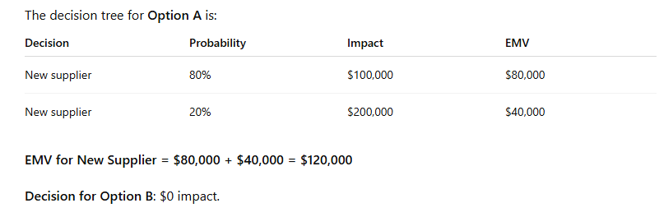
Types of Quantitative Risk Analysis

Slide 37
Key Advantages of Quantitative Risk Analysis
6. Key Advantages of Quantitative Risk Analysis
Provides numerical estimates of risk impact
Helps prioritize risks based on financial and schedule outcomes
Facilitates better decision-making by providing clear projections
Supports cost-benefit analysis and optimal risk responses

Slide 38
Limitations of Quantitative Risk Analysis
7. Limitations of Quantitative Risk Analysis
Requires good data: Accurate risk models depend on reliable historical data.
Time-consuming: Requires significant effort to gather data and perform modeling.
Complexity: Advanced models (e.g., Monte Carlo) require specialized tools and knowledge.

Slide 39
Comparison
. Overview
Qualitative Risk Analysis
Definition: The process of assessing the impact and probability of risks using non-numeric methods, often through expert judgment, brainstorming, and prioritization.
Focus: Relative ranking of risks (High, Medium, Low) based on their likelihood and impact.
Output: Risk Register with risk ratings (e.g., high, medium, low).
When Used: Early in the project when data is limited or time is constrained, or when precise data is unavailable.
Quantitative Risk Analysis
Definition: The process of assessing risks using numeric models and statistical methods to determine the magnitude and probability of their impact on project objectives.
Focus: Numerical analysis of risk impact on schedule, cost, and other project objectives.
Output: Quantified risk values (e.g., expected monetary value, Monte Carlo simulations).
When Used: For large, complex, or high-stakes projects where precise data and detailed analysis are crucial.

Slide 40
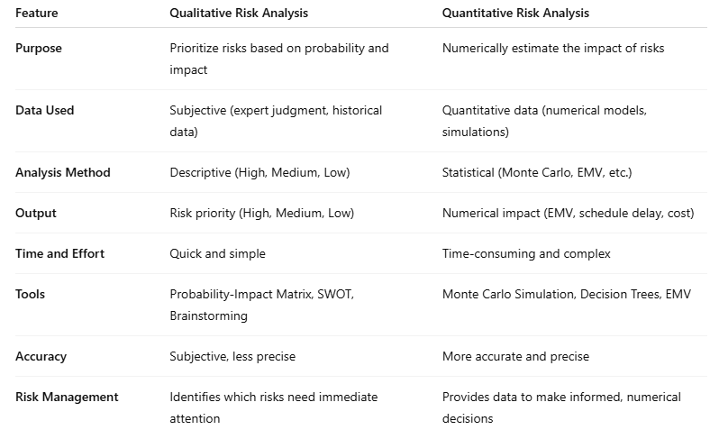
Difference

Slide 41
Example Comparison
Scenario: Software Development Project
Risk: Delay in delivery of key software components
Qualitative Risk Analysis Example
Probability: 40% chance of delay
Impact: Delay in project delivery by 2 weeks, costing $20,000
After applying Probability-Impact Matrix, this risk is assessed as High.
Risk Rating: High Priority (Needs immediate attention)
Output:
Risk Register would note: Risk: Delay in key component delivery Probability: 40% Impact: 2 weeks delay, $20,000 cost Priority: High

Slide 42
Example Comparison
Quantitative Risk Analysis Example
Expected Monetary Value (EMV):
Probability: 40% (0.4)
Impact (Cost): $20,000
EMV = Probability × Impact = 0.4 × 20,000 = $8,000
Monte Carlo Simulation:
The project manager runs a Monte Carlo simulation to model the effect of potential delays from multiple risks (e.g., key components, resource issues, testing delays) on the project's total cost.
After running 10,000 simulations, the model predicts a 90% probability that the project will exceed the budget by $15,000.
Output:
The EMV for this risk (delay) is $8,000.
Monte Carlo simulation predicts $15,000 additional cost due to risks.

Slide 43
Perform Quantitative Risk Analysis
The process of numerically analyzing the effect of identified risks on project objectives.
Used When
Large, complex, high-risk projects
Budget and schedule accuracy is critical
Techniques
Monte Carlo Simulation
Decision Tree Analysis
Expected Monetary Value (EMV)
Sensitivity Analysis
EMV Example
Risk: Server crash
Probability = 20%
Cost impact = ₹1,00,000
EMV = 0.2 × 1,00,000 = ₹20,000

Slide 44
Plan Risk Responses
The process of developing options and actions to address risks.
Strategies for Negative Risks (Threats)
Avoid
Eliminate the risk
Example: Use proven technology instead of new one
Mitigate
Reduce probability or impact
Example: Add extra testing to reduce defects
Transfer
Shift risk to third party
Example: Insurance, outsourcing
Accept
Take no action
Example: Small delay risk accepted

Slide 45
Plan Risk Responses
Strategies for Positive Risks (Opportunities)
Exploit
Ensure opportunity happens
Example: Assign best resources to finish early
Enhance
Increase probability or benefit
Example: Add skilled staff to improve performance
Share
Partner with others
Example: Joint venture
Accept
Take advantage if it occurs

Slide 46
Implement Risk Responses
The process of executing the planned risk response actions.
Key Points
Risk owners implement responses
Actions are added to project schedule
Requires coordination and tracking
Example
Risk: Data loss Response: Daily automated backups Implementation: Backup system installed

Slide 47
Monitor Risks
The process of tracking identified risks, monitoring residual risks, and identifying new risks.
Activities
Risk audits
Risk reviews
Status meetings
Update risk register
Check effectiveness of responses
Example
A previously low-risk vendor delay becomes high-risk due to supply chain issues.

Slide 48
Risk Categories (RBS – Risk Breakdown Structure)
Common categories:
Technical risks
Schedule risks
Cost risks
Resource risks
External risks
Organizational risks

Slide 49
Key Benefits of Risk Management
Reduced uncertainty
Better planning
Higher success rate
Improved stakeholder confidence
Better cost and schedule control

Slide 50
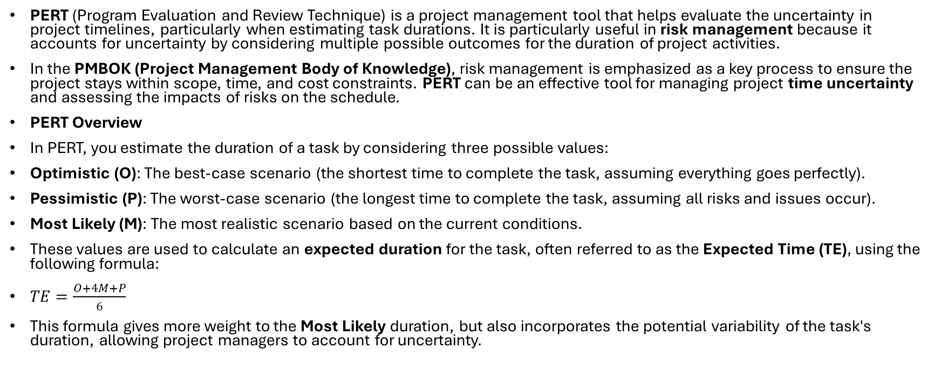
PERT and Risk Management
PERT (Program Evaluation and Review Technique) is a project management tool that helps evaluate the uncertainty in project timelines, particularly when estimating task durations. It is particularly useful in risk management because it accounts for uncertainty by considering multiple possible outcomes for the duration of project activities.
In the PMBOK (Project Management Body of Knowledge), risk management is emphasized as a key process to ensure the project stays within scope, time, and cost constraints. PERT can be an effective tool for managing project time uncertainty and assessing the impacts of risks on the schedule.
PERT Overview
In PERT, you estimate the duration of a task by considering three possible values:
Optimistic (O): The best-case scenario (the shortest time to complete the task, assuming everything goes perfectly).
Pessimistic (P): The worst-case scenario (the longest time to complete the task, assuming all risks and issues occur).
Most Likely (M): The most realistic scenario based on the current conditions.
These values are used to calculate an expected duration for the task, often referred to as the Expected Time (TE), using the following formula:
$TE=\frac{O+4M+P}{6}$
This formula gives more weight to the Most Likely duration, but also incorporates the potential variability of the task's duration, allowing project managers to account for uncertainty.

Slide 51
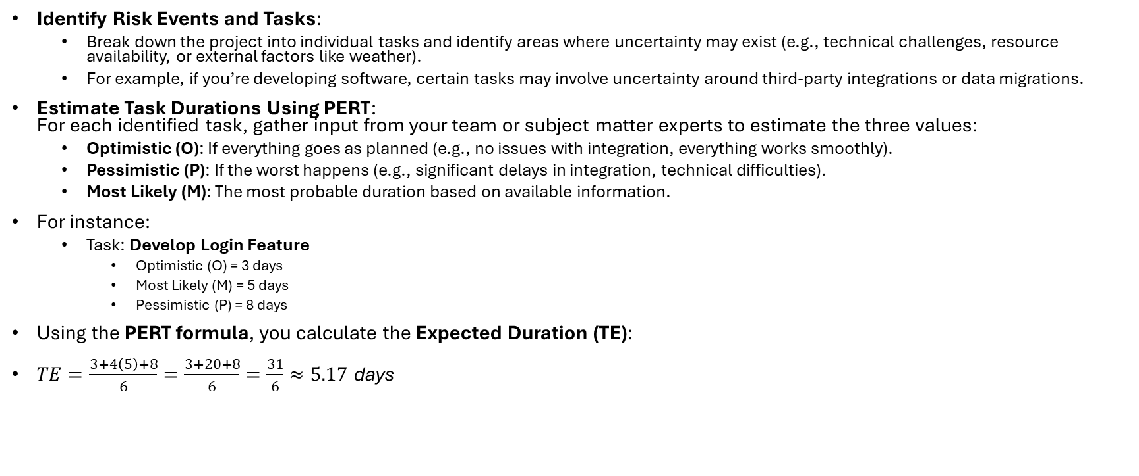
Step-by-Step: Using PERT to Manage Uncertainty in a Project
Identify Risk Events and Tasks:
Break down the project into individual tasks and identify areas where uncertainty may exist (e.g., technical challenges, resource availability, or external factors like weather).
For example, if you’re developing software, certain tasks may involve uncertainty around third-party integrations or data migrations.
Estimate Task Durations Using PERT: For each identified task, gather input from your team or subject matter experts to estimate the three values:
Optimistic (O): If everything goes as planned (e.g., no issues with integration, everything works smoothly).
Pessimistic (P): If the worst happens (e.g., significant delays in integration, technical difficulties).
Most Likely (M): The most probable duration based on available information.
For instance:
Task: Develop Login Feature
Optimistic (O) = 3 days
Most Likely (M) = 5 days
Pessimistic (P) = 8 days
Using the PERT formula, you calculate the Expected Duration (TE):
$TE=\frac{3+4\left(5\right)+8}{6}=\frac{3+20+8}{6}=\frac{31}{6}≈5.17 \text{days}$

Slide 52
Step-by-Step: Using PERT to Manage Uncertainty in a Project
Construct the PERT Network:
Create a PERT chart (a flowchart of tasks, their dependencies, and estimated durations).
The chart allows you to visualize the sequence of tasks, identify critical paths, and understand where uncertainty might affect the overall project schedule.
Assess the Project Schedule Risk:
Calculate the Expected Project Duration by applying PERT estimates across all tasks.
Critical Path Method (CPM) can be combined with PERT to identify the critical path, which is the longest path in the project. Delays in tasks on the critical path will directly impact the project’s completion date.
Risk Identification: If a task has high uncertainty (e.g., a large difference between optimistic and pessimistic estimates), it should be flagged for potential risks.
Risk Analysis (Quantitative):
You can simulate the effects of different risks on the schedule using Monte Carlo simulations to model different scenarios based on the PERT estimates.
By generating multiple possible scenarios with varying task durations, you can estimate the likelihood of completing the project within a given timeframe, considering all uncertainties.
Monitor and Adjust:
During project execution, continually track task progress. If tasks are slipping into the pessimistic range (P), reevaluate and adjust the project schedule, resources, or scope to mitigate risk.
You can also update your PERT estimates if new risks emerge or if the project's scope changes.

Slide 53
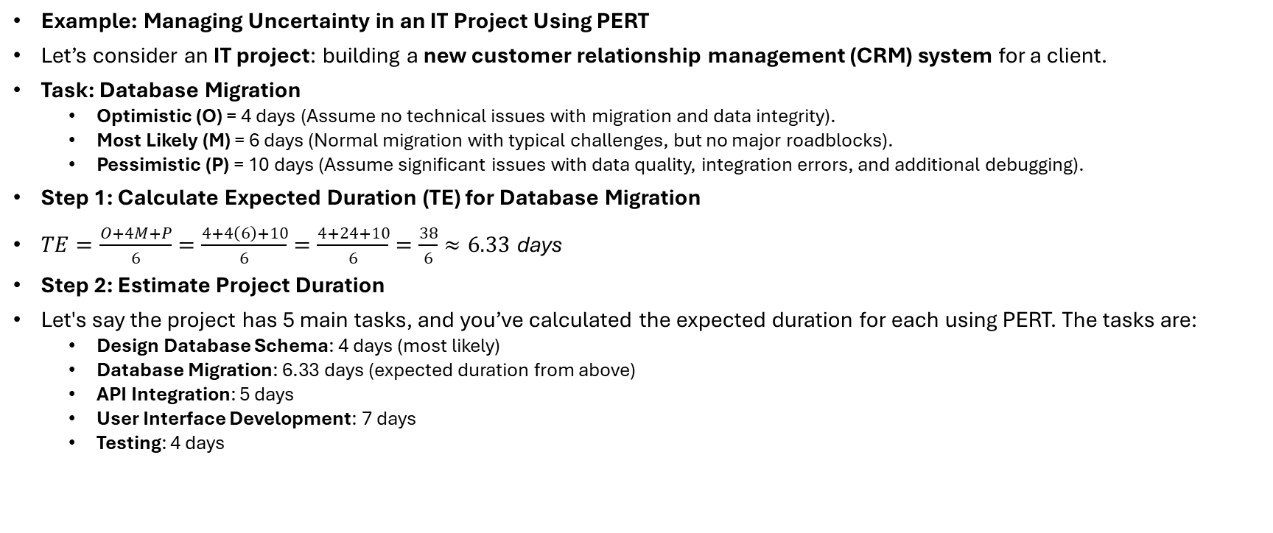
Step-by-Step: Using PERT to Manage Uncertainty in a Project
Example: Managing Uncertainty in an IT Project Using PERT
Let’s consider an IT project: building a new customer relationship management (CRM) system for a client.
Task: Database Migration
Optimistic (O) = 4 days (Assume no technical issues with migration and data integrity).
Most Likely (M) = 6 days (Normal migration with typical challenges, but no major roadblocks).
Pessimistic (P) = 10 days (Assume significant issues with data quality, integration errors, and additional debugging).
Step 1: Calculate Expected Duration (TE) for Database Migration
$TE=\frac{O+4M+P}{6}=\frac{4+4\left(6\right)+10}{6}=\frac{4+24+10}{6}=\frac{38}{6}≈6.33 \text{days}$
Step 2: Estimate Project Duration
Let's say the project has 5 main tasks, and you’ve calculated the expected duration for each using PERT. The tasks are:
Design Database Schema: 4 days (most likely)
Database Migration: 6.33 days (expected duration from above)
API Integration: 5 days
User Interface Development: 7 days
Testing: 4 days

Slide 54
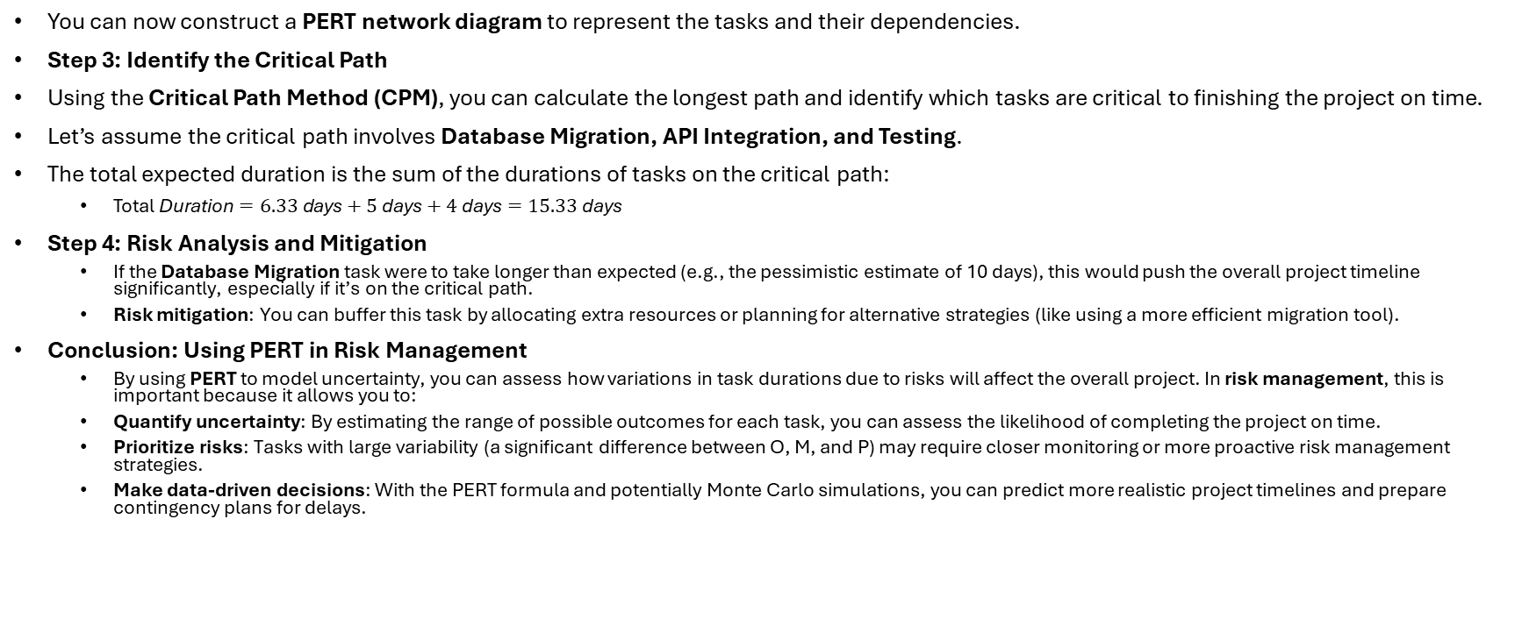
Step-by-Step: Using PERT to Manage Uncertainty in a Project
You can now construct a PERT network diagram to represent the tasks and their dependencies.
Step 3: Identify the Critical Path
Using the Critical Path Method (CPM), you can calculate the longest path and identify which tasks are critical to finishing the project on time.
Let’s assume the critical path involves Database Migration, API Integration, and Testing.
The total expected duration is the sum of the durations of tasks on the critical path:
$\text{Total} \text{Duration}=6.33 \text{days}+5 \text{days}+4 \text{days}=15.33 \text{days}$
Step 4: Risk Analysis and Mitigation
If the Database Migration task were to take longer than expected (e.g., the pessimistic estimate of 10 days), this would push the overall project timeline significantly, especially if it’s on the critical path.
Risk mitigation: You can buffer this task by allocating extra resources or planning for alternative strategies (like using a more efficient migration tool).
Conclusion: Using PERT in Risk Management
By using PERT to model uncertainty, you can assess how variations in task durations due to risks will affect the overall project. In risk management, this is important because it allows you to:
Quantify uncertainty: By estimating the range of possible outcomes for each task, you can assess the likelihood of completing the project on time.
Prioritize risks: Tasks with large variability (a significant difference between O, M, and P) may require closer monitoring or more proactive risk management strategies.
Make data-driven decisions: With the PERT formula and potentially Monte Carlo simulations, you can predict more realistic project timelines and prepare contingency plans for delays.

